Slide 1

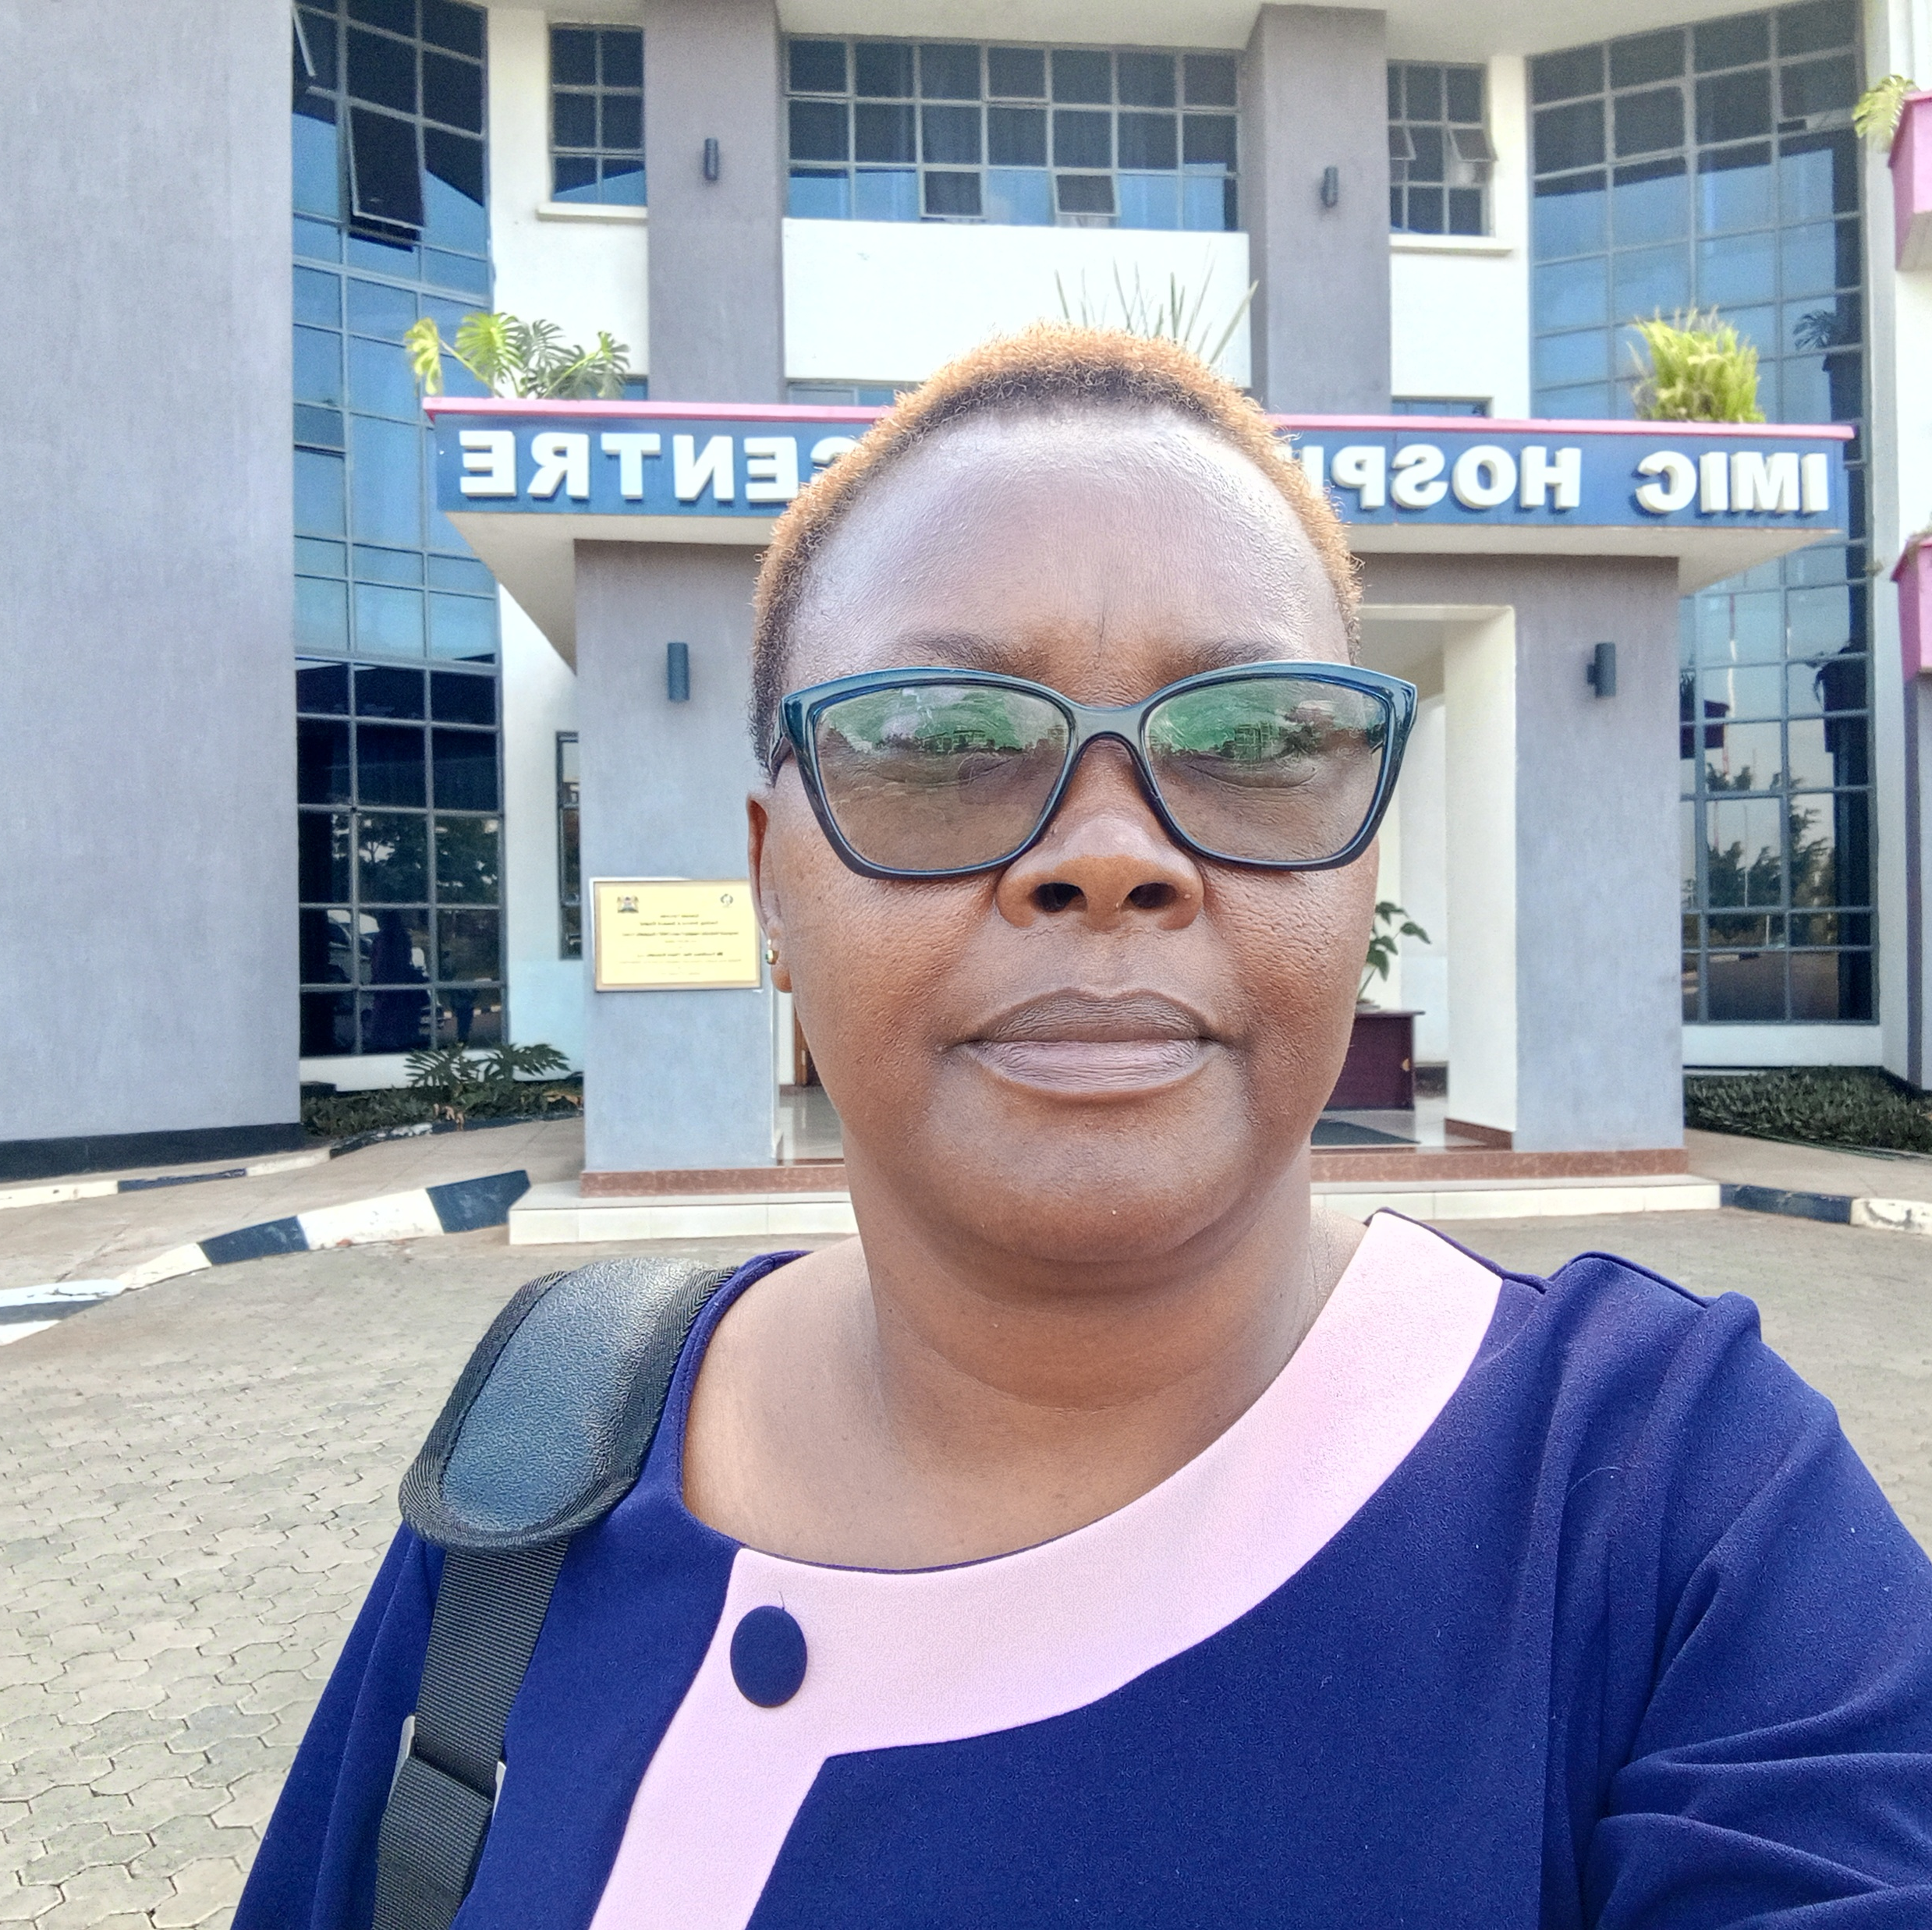
Reducing Turn Around Time (TAT) For Social Health Insurance Fund (SHIF) Discharge Process At Coast General Teaching And Referral Hospital(CGTRH)
ANN MUMBUA,
BSc PH,RN
Coast General Teaching and Referral Hospital

Slide 2
Introduction
Definition
Social Health Insurance Fund is a financing scheme aimed to improve access to affordable, quality healthcare covering preventive, promotive ,curative, palliative and rehabilitative services
Delays in SHIF discharge have been noted leading to prolonged hospital stay, reduced patient satisfaction and safety and enhances the risk of hospital acquired infections.

Slide 3
Introduction Cont..
The SHIF discharge process begins when patient arrives at SHIF office to the time they are issued with release form.
Client interviews highlighted prolonged delays ranging from hours to days.
Piloted in a Surgical Ward and Maternity
Baseline SHIF discharge Median Turnaround tme(TAT) in March 2025 was 19 hours.

Slide 4
Introduction Cont..
Objective
To reduce SHIF discharge TAT from 19 hours in March 2025 to 6 hours by 30th June 2025.

Slide 5
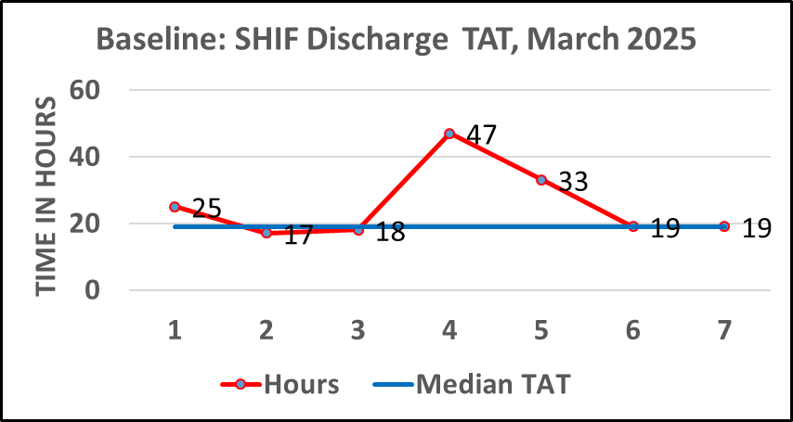
Introduction Cont..
Median: SHIF discharge TAT of 19 Hours. Range: 17-47 Hours

Slide 6
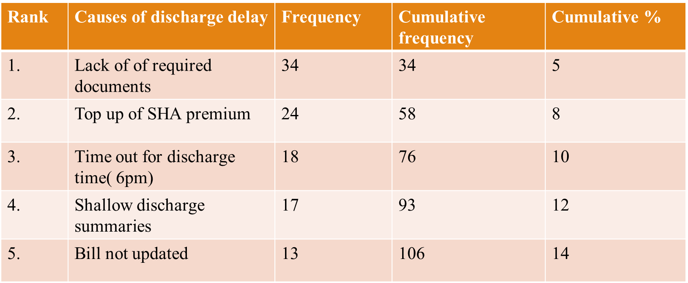
Method
Root cause analysis was done using Pareto Chart
Causes of discharge delay

Slide 7
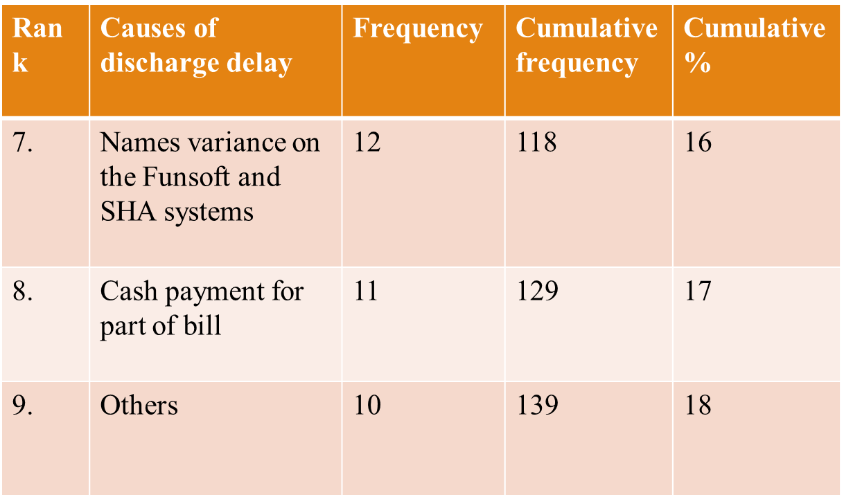
Method Cont..
Pareto Chart shows the top 4 causes chronologically are:
Lack of required documents
Top up SHA premiums
Time out for discharge time
Shallow discharge summary

Slide 8
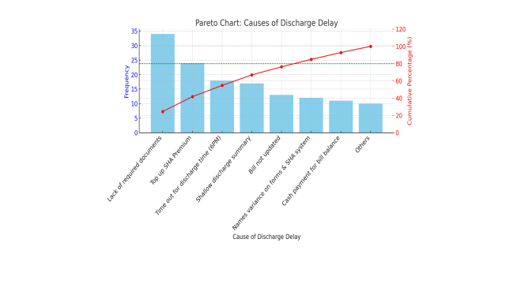
Method Cont..

Slide 9
Method Cont..
Main focus root causes:
Lack of Discharge document requirements
Missed Surgical and diagnostic pre-authorization
Key drivers
Enhance knowledge of staff and patient discharge process requirement
Streamline admission process
Accessibility of all required discharge documents
Efficient multidisciplinary communication

Slide 10
Intervention
Sensitize stakeholders including doctors, nurses, admission clerks, health information officers, SHIF team and patients.
Redesign admission process at maternity department.
Availing required SHIF discharge documents at admission desk and pilot inpatients units

Slide 11
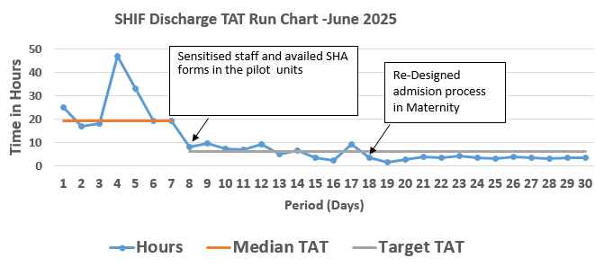
Results

Slide 12
Results Cont..
Sensitization and availing of required SHIF discharge Documents at the units reduced SHIF discharge TAT by 50% (from 19 to 9 Hours),
Redesigning of maternity Admission process further reduced the SHIF discharge TAT to 3.2 Hours

Slide 13
Sustainability measures
Work flow Standard Operating Procedure (SOP) to standardize SHIF admission and discharge process across the piloted departments
Scale up SHIF discharge project to all other admitting units and relevant departments.
Include SHIF admission and Discharge processes in the new staff on-boarding process
Continuous Monitoring the scaled up and implementation of the standardized process.

Slide 14
Challenges
System failure - Funsoft and SHA
Lack of patient's identification cards
Few number Human resource

Slide 15
Conclusion
Efficient discharge process will:-
Minimize risks for hospital Acquired Infections
Improve patient satisfaction and safety
Enhance resource utilization, cost effectiveness and operational efficiency
Increases staff efficiency and morale
Increases bed availability for incoming patient improving patient flow

Slide 16
Acknowledgement
Coast General Teaching and Referral Hospital Leadership
The Africa Consortium for Quality Improvement Research
Quality ,Safety and Standards department
Surgical and Maternity department staff
Social Health Insurance Fund staff
IPNET

Slide 17
THANK YOU

